Slide 1
µCoaching
When goals become reality...
Filip Gulán, Jan Herec, Marek Marušic

Slide 2
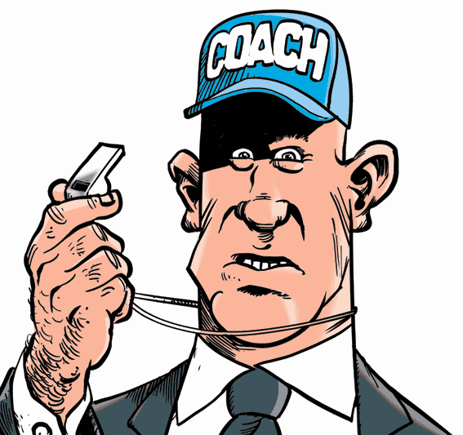
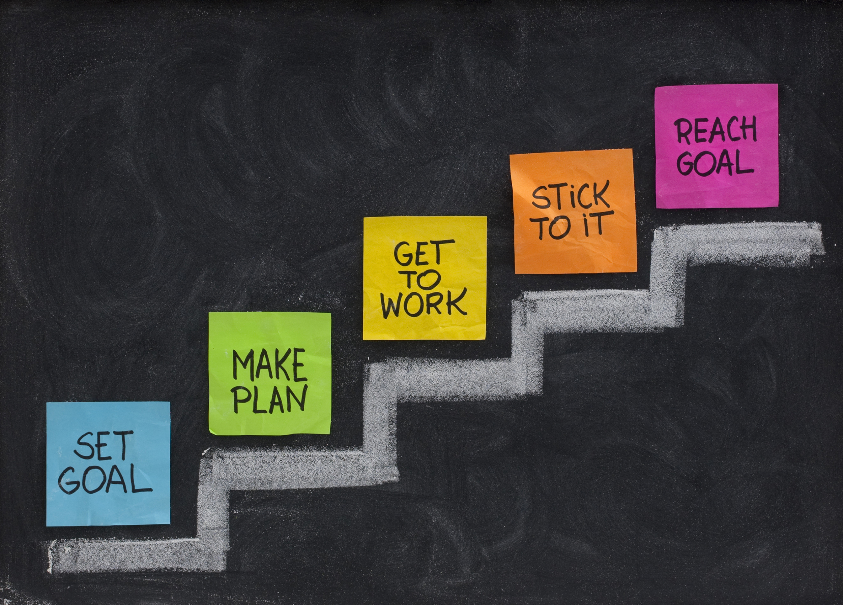
App introduction
Aimed on micro coaching
2 participants (usually) - performer and his coach (or coaches)
Performer sets goal and coach helps/motivates him to achieve this goal
Bidirectional conversation (brief exchange) between performer and coach
Performer is pushed forward to complete his goal by rating his progress
The progress rating is visualized in the graph
App user can coach and perform more goals
Notes:
Our application is aimed on microcoaching. What is the basis of microcoaching? Well, there are usually 2 participants - the performer and his coach. Performer sets goal and coach helps or motivates him to achieve this goal. Our app provide bidirectional conversation respective brief exchange between performer and the coach.
Performer is pushed forward to complete his goal by rating his progress and by milestone checking. This progress rating is visualised in the graph. User of app can of course coach and perform more goals.

Slide 3

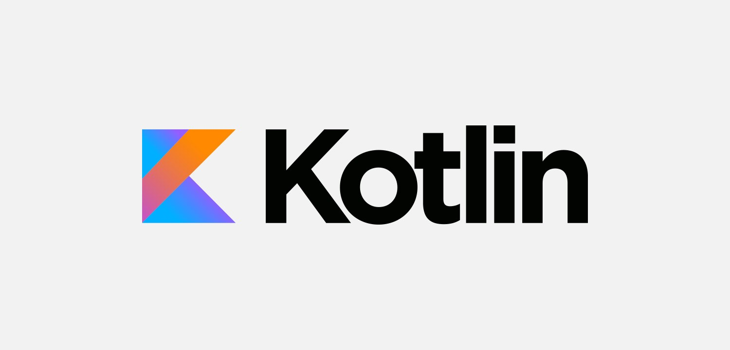
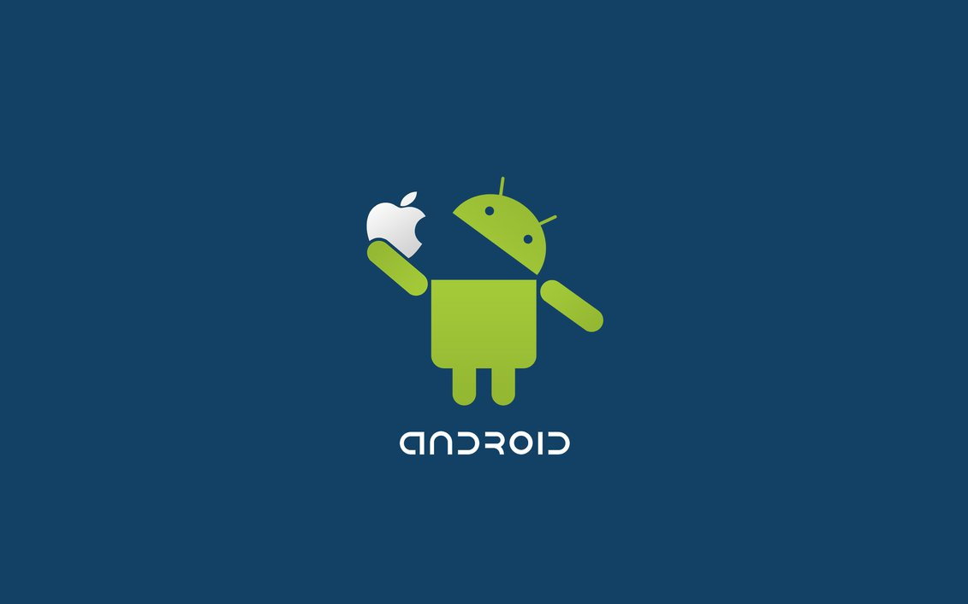
Platform
Android (phones)
Java/Kotlin
Firebase
Advantages
nearly 90% market share (According to IDC)
Googleplay platform
availability
Firebase simplicity
Native app
Disadvantages
Firebase 100 simultaneous connections limit
wide range of devices

Slide 4
Similar projects
Similar apps:
TODO lists
Slightly similar app in the past, focused for fitness and medical uses (Dead)
There are apps which can help you to find coach, but they are not focused on coaching itself.
Coaching apps missing human factor
Uniqueness of our app:
Not another TODO list
Embrace the friendship between the people
Human factor
Any type of goal
Notes:
There are apps like todo lists or habit trackers. In the past there was a similar app for fitssness and medical goals. There were professional coaches. The app was for IOS and it is not available any more.
There are apps which can help you find you coaches. Most of these apps are missing the human factor. Our app is not a todo list. It embraces the friendship between coach and the performer. Which gives you bigger motivation and of course you can have what ever type of the goal you want.

Slide 5
The master plan
Complete it as soon as possible!!!
1. 5. First consultation
26.6. Create Mockups
12.8. Create UML diagrams
21.8. Evaluate mockups and diagrams
16.9. Prototype of Performer mode
24.9. Present the proposed project
8.10. First prototype of the whole app
22.10. Fix issues with design and in the app
5.11. Version 1.0 finished
8.12. Finish and publish the project.
Notes:
We started work on this app a little bit earlier. We have already scetched some mockups and UML diagrams. Last week we finished a prototype of performer mode and we plan to have the prototype of the coach mode in two weeks. Then we will evaluate and fix issues with design and the app itself. Our goal is to have the app finished as soon as possible, since we would like to test it on ourselves for our diploma thesis.

Slide 6
Q&As
Thank you for your attention.

